Slide 2
Key
DOCR: Dissolved organic carbon, recalcitrant
DOCL: Dissolved organic carbon, labile
POC: Particulate organic carbon
TP: Total phosphorus
DO: Dissolved oxygen
DIC: Dissolved inorganic carbon
Water quality metrics as DO, POC, Clarity
atmosphere
atmospheric exchange
DOC_{L,R}
respiration (R)
NPP
(POC_{L},DOC_{L} only)
DO
POC_{L,R}
Load, Export
DIC
P
epilimnion
settling
entrainment (E)
hypolimnion
DOC_{L,R}
respiration
DO
POC_{L,R}
P
settling
DIC
respiration
respiration
settling
binding
recycling
release
active
sediments
P_{B},P_{OC}
POC_{L,R}
Permanent Burial

Slide 3
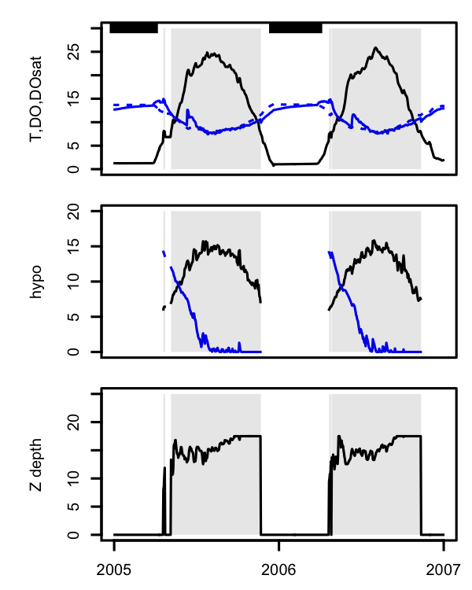
A) Epilimnion
Ice cover
DO
DO_{Sat}
Temperature
Temperature (◦C), DO (g m⁻³)
B) Hypolimnion
Temperature
DO
C
Thermocline
depth (m)
PlotAnnualCycles.R

Slide 4
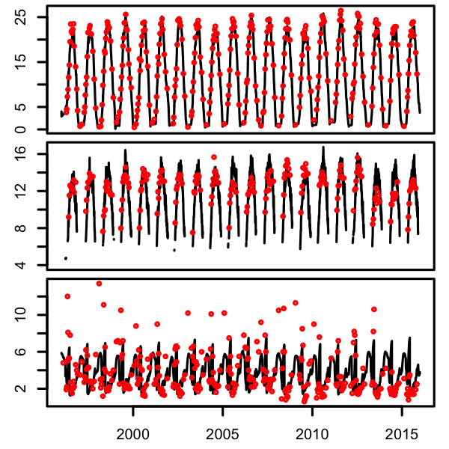
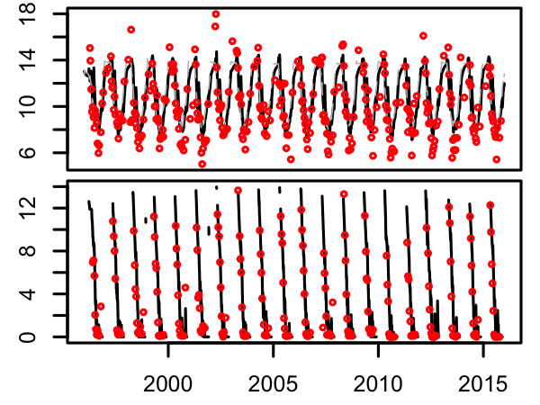
Calibration, eutrophic
Epilimnion
Water temperature (C)
Hypolimnion
Secchi depth (m)
Epilimnion
Dissolved oxygen (mg L⁻¹)
Hypolimnion
This is 10 pt font
ComparePredictionsObservations.R; paste together two files
ComparePredictionsObservations.R

Slide 5
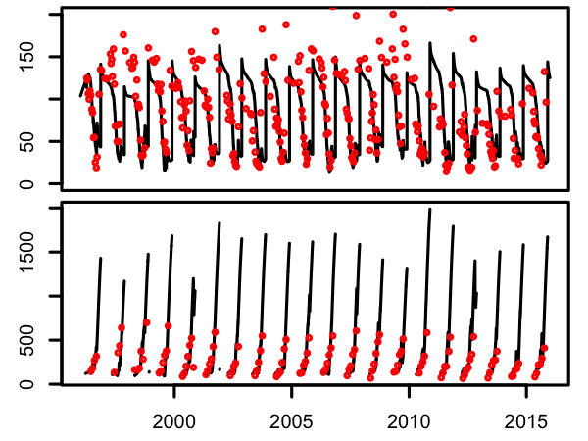
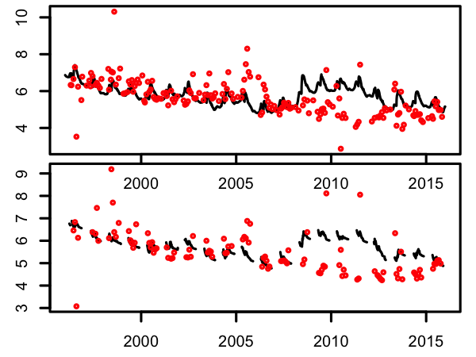
Calibration, eutrophic
Epilimnion
Total phosphorus (ug L⁻¹)
Hypolimnion
Epilimnion
Dissolved organic carbon (mg L⁻¹)
Hypolimnion
ComparePredictionsObservations.R; paste together 2 files

Slide 6
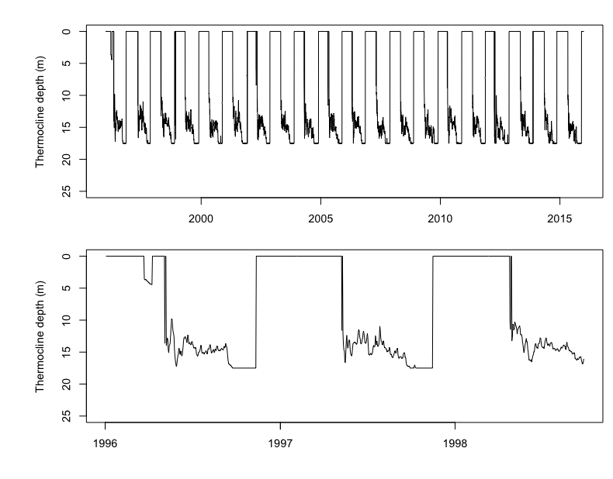
Thermocline depth through time

Slide 7
Depth (m) | Area (m^2)
0 | 39850000
1 | 3.60E+07
2 | 3.40E+07
3 | 32100000
4 | 30300000
5 | 28700000
6 | 27800000
7 | 2.70E+07
8 | 2.60E+07
9 | 2.50E+07
10 | 2.40E+07
11 | 22700000
12 | 21100000
13 | 19900000
14 | 18400000
15 | 17600000
16 | 16400000
17 | 15200000
18 | 13700000
19 | 11300000
20 | 8600000
21 | 5900000
22 | 3500000
23 | 1600000
24 | 1.00E+05
25 | 0
Lake hypsometry

Slide 8
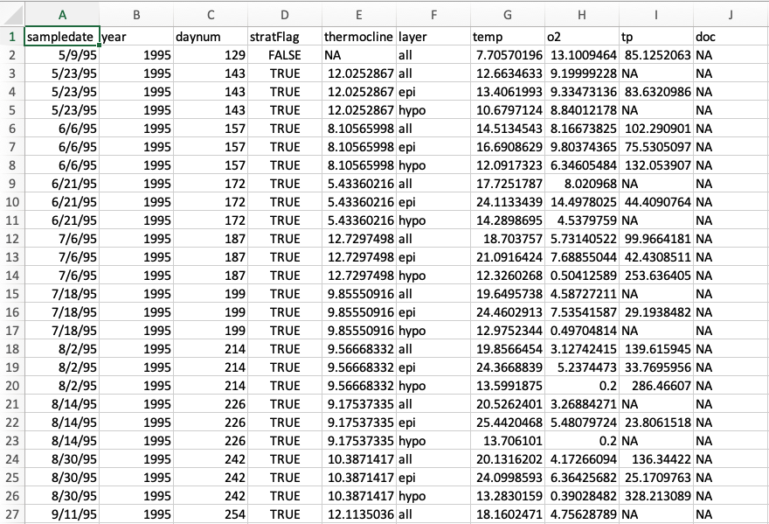
Example observational data file

